Slide 1
Analyzing and Minimizing Loan Investment Risks using Random Forest Classifier
By Group 3:
-Shashi Kumar Kadari Mallikarjuna
-Aradhya Alva Rathnakar
-Bhavan Kumar Basavaraju
-Mahamaya Panda
-ReddySaketh Reddy Chappidi

Slide 2
TABLE OF CONTENTS
Introduction
Problem Statement
Motivation
Development Methodology: Crisp DM
Data Flow Diagram
Dataset Description and Collection Method
Objectives
Exploratory Data Analysis
Google Survey (Snapshots and Analysis Report)
Data Pre-processing (Cleansing, Transformation, and Reduction)
Data Modeling
Data Visualization
Deployment
Impact
Conclusion
Future Scope
References

Slide 3

INTRODUCTION
Banking and finance are the backbones of the world economy. The size of a particular country's banking sector shows how big that country's GDP might be.
Most legal transactions happen through the banking system, and there is a need to ensure the security of funds in financial institutions to build trust.
Banks make the majority of their money by lending out the investors' money to the people who need it for buying a house, car, personal reasons, etc., for a specific interest rate. These banks will face a loss if the borrowers don’t return the borrowed money.
In this project, we look at different factors that could be considered before giving out a loan to ensure that the loan is only sanctioned to people who can repay it.

Slide 4

Online financial services that emerged with the growth of blockchain technology and the crypto market have disrupted traditional banking systems by offering lower interest rates due to reduced infrastructure costs. However, to maintain viability, such services require a thorough vetting process to reduce the number of defaulters. To address this problem, predictive analytics, specifically the use of a Random Forest Classifier, can be employed to analyze various factors such as credit history, income, employment status, debt-to-income ratio, etc. of borrowers to detect potential defaulters. This approach will enable well-informed decision-making and reduce the risk of defaults.

Slide 5


MOTIVATION
Lending money is a crucial aspect of the financial industry. Banks and other lending institutions have been using traditional credit scoring methods and models to assess the risk associated with lending money. Traditional risk assessment methods have relied on credit scores and financial history, but these measures don’t always provide a complete picture of the borrower's ability to repay the loan. In the last 4 months, many banks including First Republic Bank went under and were acquired by JPMorgan Chase Bank. It has become all the more important in the recent times to keep the operating costs and losses low for any financial institution to survive in the market.

Slide 6
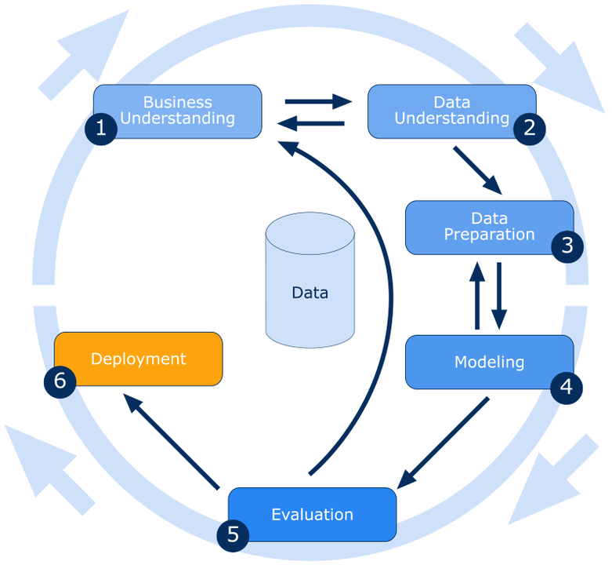
DEVELOPMENT METHODOLOGY: CRISP DM
Notes:
The CRoss Industry Standard Process for Data Mining

Slide 7
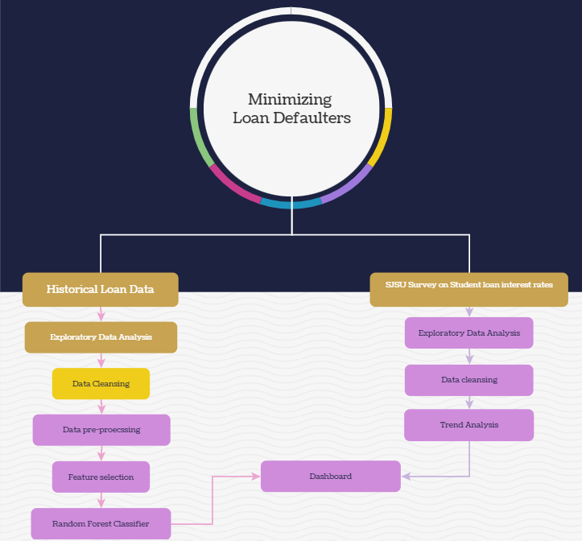
DATA FLOW DIAGRAM:

Slide 8
DATASET DESCRIPTION AND DATA COLLECTION
Name
Data Collection Method
Description
Minimizing risks for Loan investment
Kaggle
Analyze the loan data of LendingClub company, and predict the possible defaulters using Random Forest Classifier helping to identify high-risk and low-risk loan groups
SJSU live survey dataset
Google form
Live survey filled out by SJSU students used for trend analysis

Slide 9
OBJECTIVES
Python libraries like pandas, and sklearn
Python and Power BI
Power BI
Google forms and Power BI
Cleanse data, develop and evaluate machine learning model to predict loan defaulters and improve loan acceptance/interest rates.
Visualize historical data to identify patterns and trends in the loan data
Provide insights into borrower creditworthiness and identify areas for improvement to reduce risk and improve profitability for investors.
Visualize the student loans interest rates that the current SJSU students are paying using the live survey

Slide 10
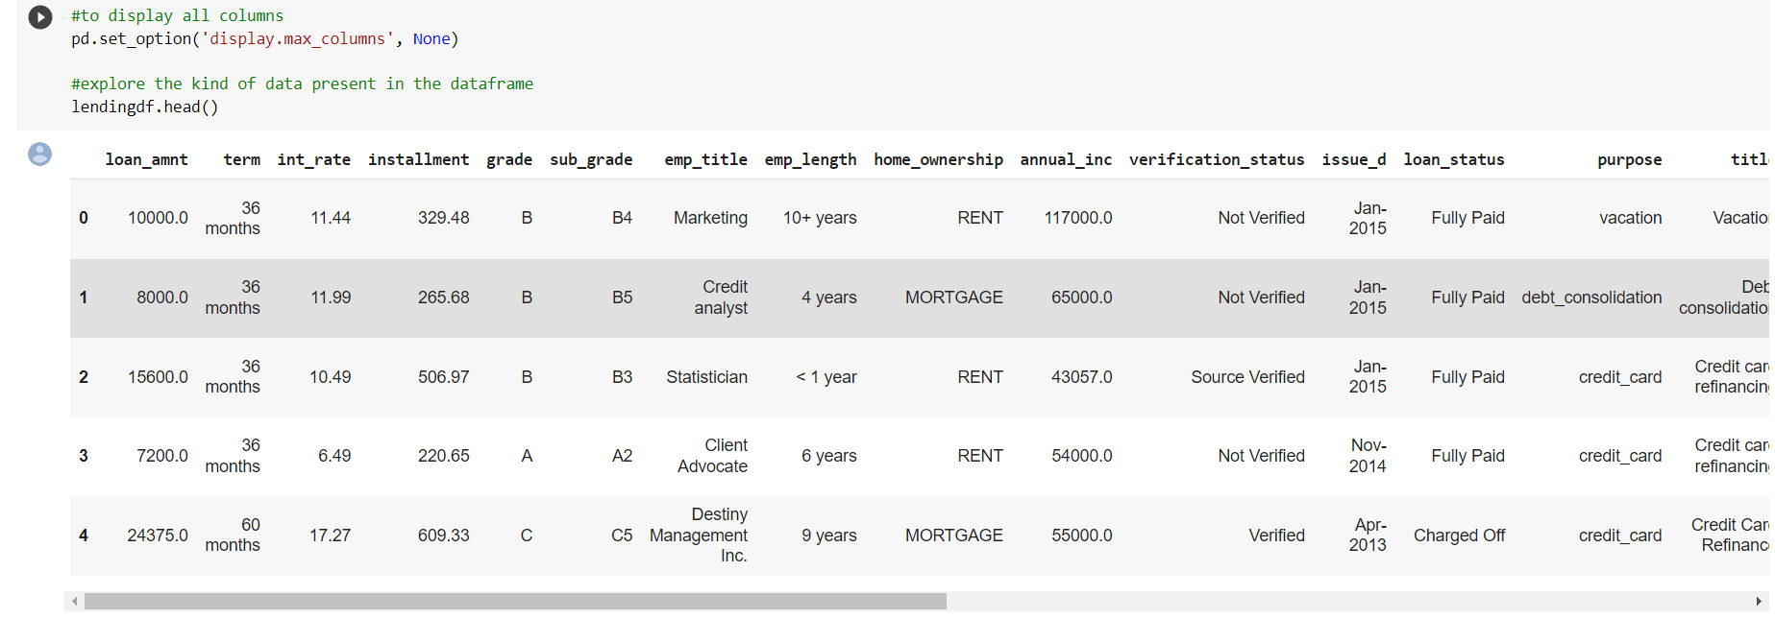
EXPLORATORY DATA ANALYSIS
LENDING CLUB DATA
The exploration of data is the key to solving any complex problem. Initial data exploration was done using various visuals to get a good understanding of the data. Python libraries like pandas, matplotlib, seaborn, etc were used for exploratory data analysis. Once the data from Kaggle was loaded into a dataframe using the Pandas library, we went on to look at the kind of data we were dealing with by displaying the top 5 rows in the dataset.

Slide 11
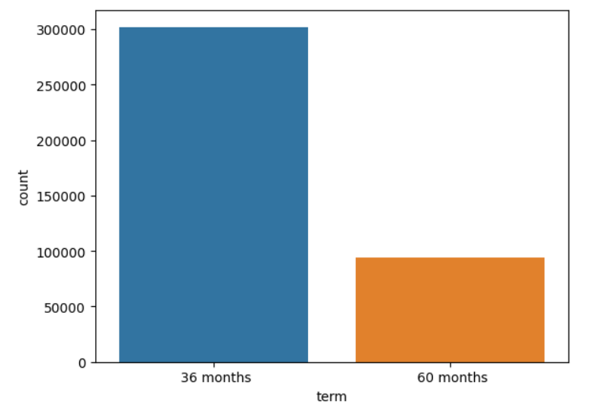
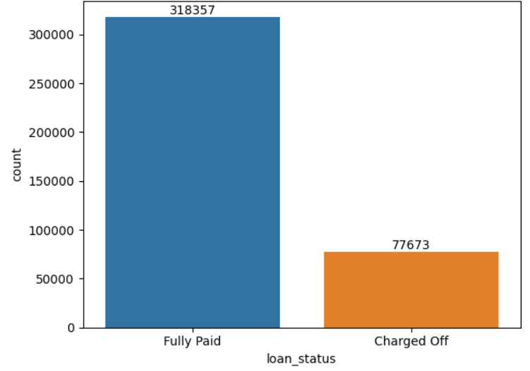
EXPLORATORY DATA ANALYSIS
To understand the number of loans that were approved for each loan repayment term to see how long the people usually prefer to repay the loan, we used a bar plot.
From the first plot, we can see that people prefer 36 months loan repayment term with almost 300,000 people taking a loan for a repayment period of 36 months as compared to a little less than 100,000 people who took a loan for a loan repayment period of 60 months.
We also wanted to know the number of people who repaid the loan on time and the number of people who charged off/ did not pay the loan to understand the impact it might have on a financial institutions.
From the second bar plot, we can see that almost 20 % of the people who have taken a loan did not repay the loan and this has a great impact on the interest rates that the financial institution is charging.

Slide 12
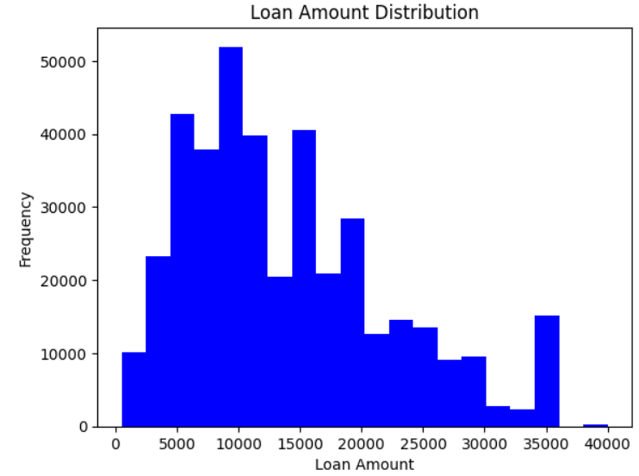
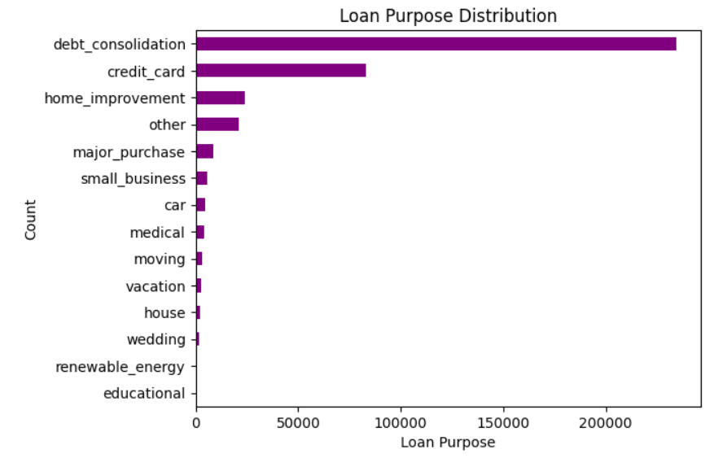
EXPLORATORY DATA ANALYSIS
From the histogram, we can see that the majority of loans are between 0 and 20,000 dollars, with the highest frequency occurring at around 10,000 dollars. The distribution is right-skewed, indicating that there are fewer loans with very high amounts that are skewing the distribution toward the right.
From this horizontal bar chart, we can say that the debt consolidation is the most common loan purpose, followed by credit card and home improvement. The range of counts varies widely between loan purposes, with the highest count being for debt consolidation (over ~200,000), and the lowest count being for educational purposes (less than ~1,500).

Slide 13
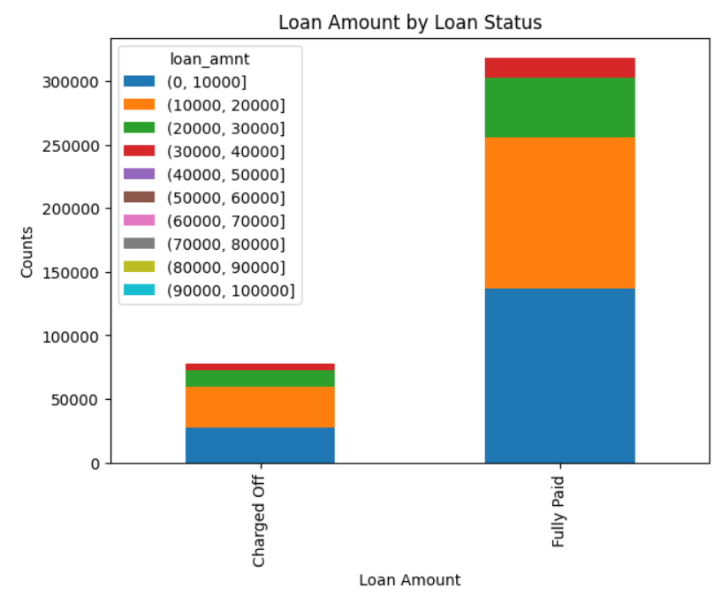
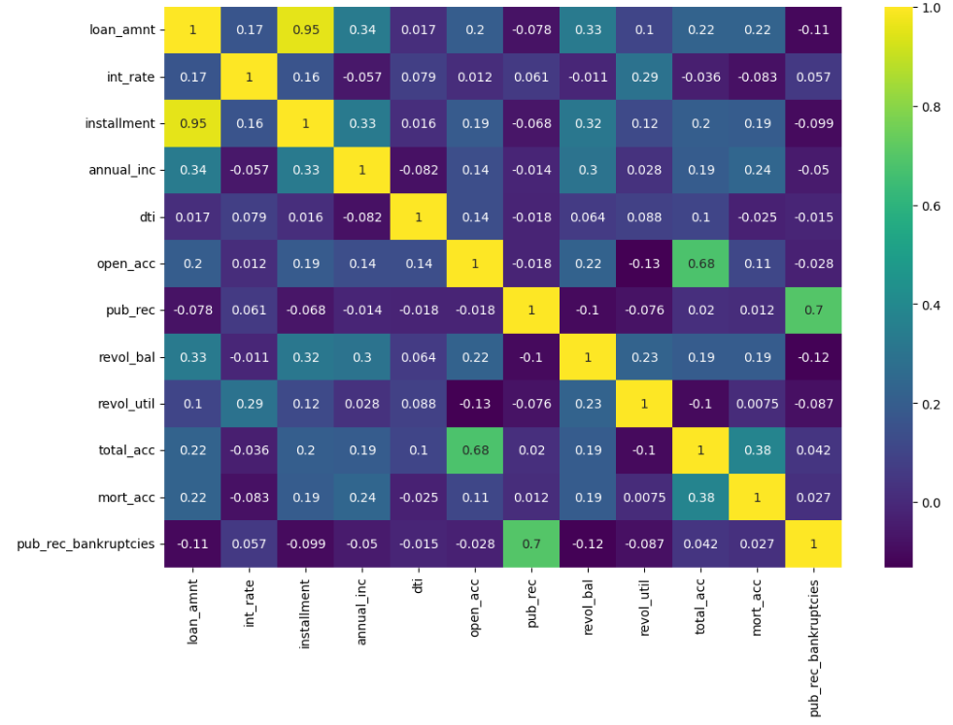
EXPLORATORY DATA ANALYSIS
The first plot is grouping the loans by their status and bins then based on their loan amounts into different categories, ranging from 0-10,000 to 90,000-100,000. The resulting plot is a stacked bar chart that shows the count of loans in each loan amount category, separated by their loan status. We can see that the majority of loans fall in the 0-20,000 category, and most of those loans are fully paid. There are fewer loans in the higher loan amount categories and the proportion of charged-off loans increases as the loan amount increases.
Based on the heatmap, we can see that there is a strong positive correlation between the loan amount and installment, indicating that borrowers who take out larger loans also have higher monthly installment payments. There is a moderate positive correlation between the loan amount and annual income, indicating that borrowers with higher incomes tend to take out larger loans.

Slide 14
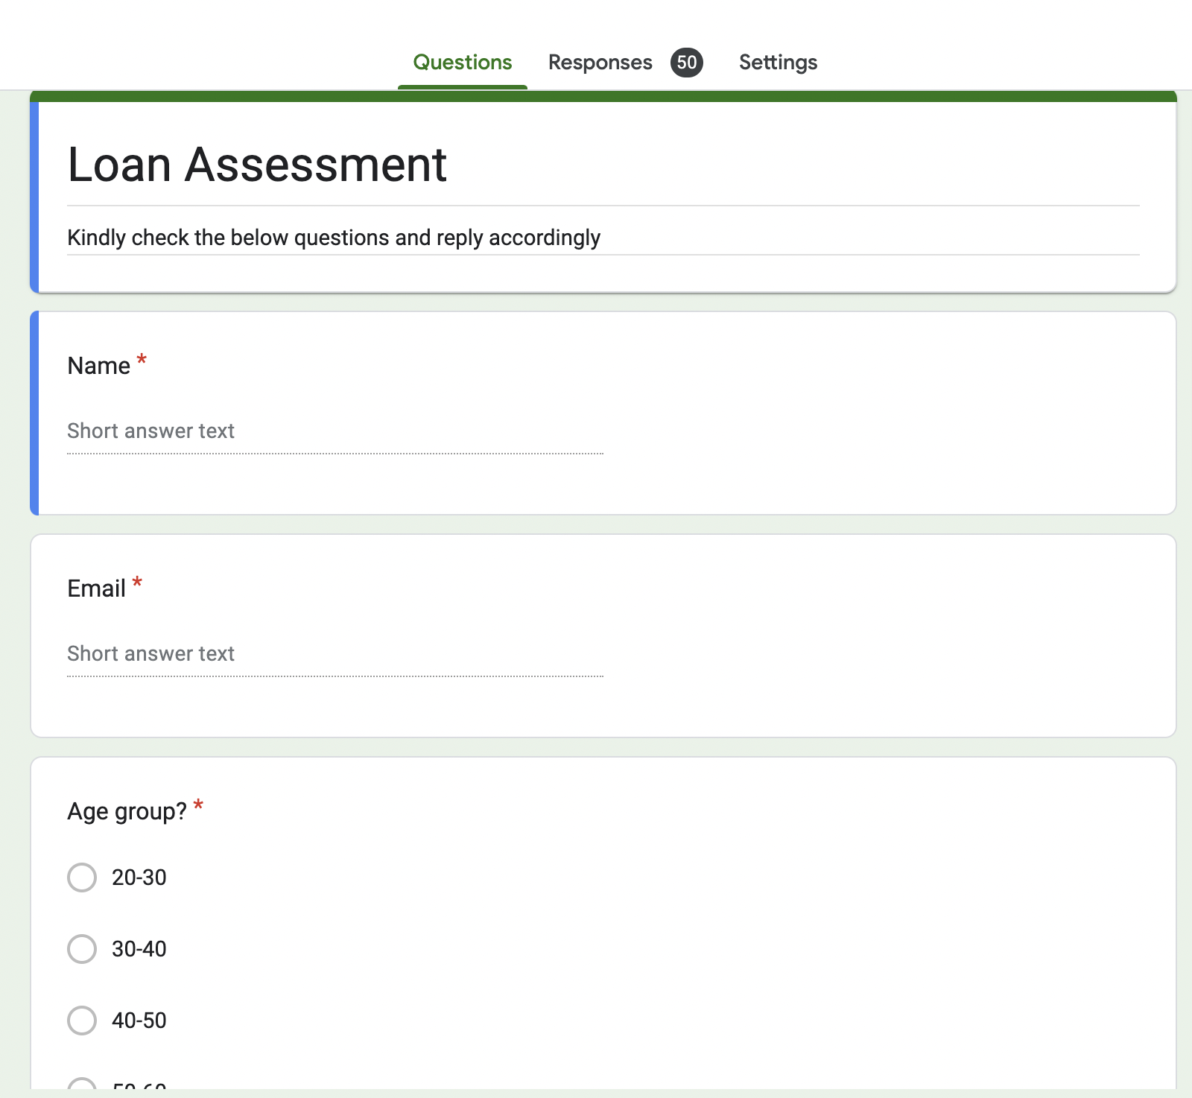
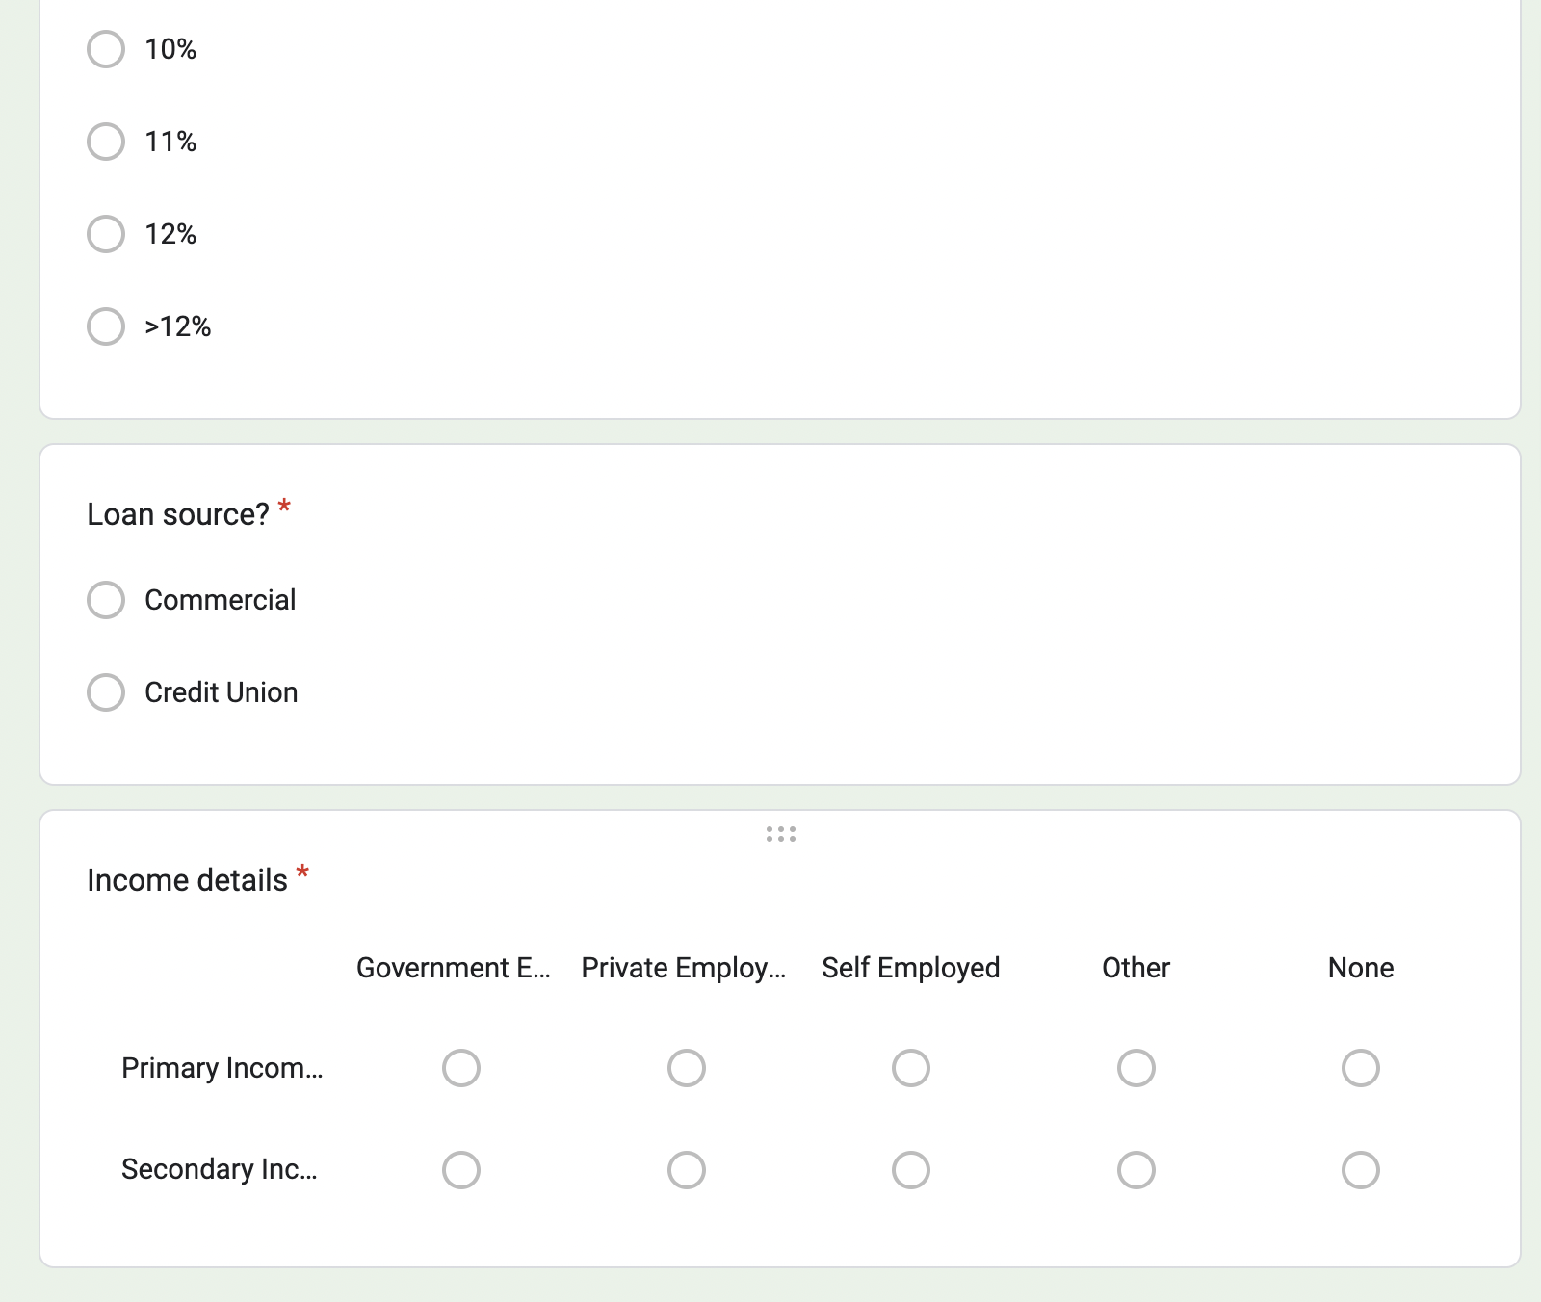
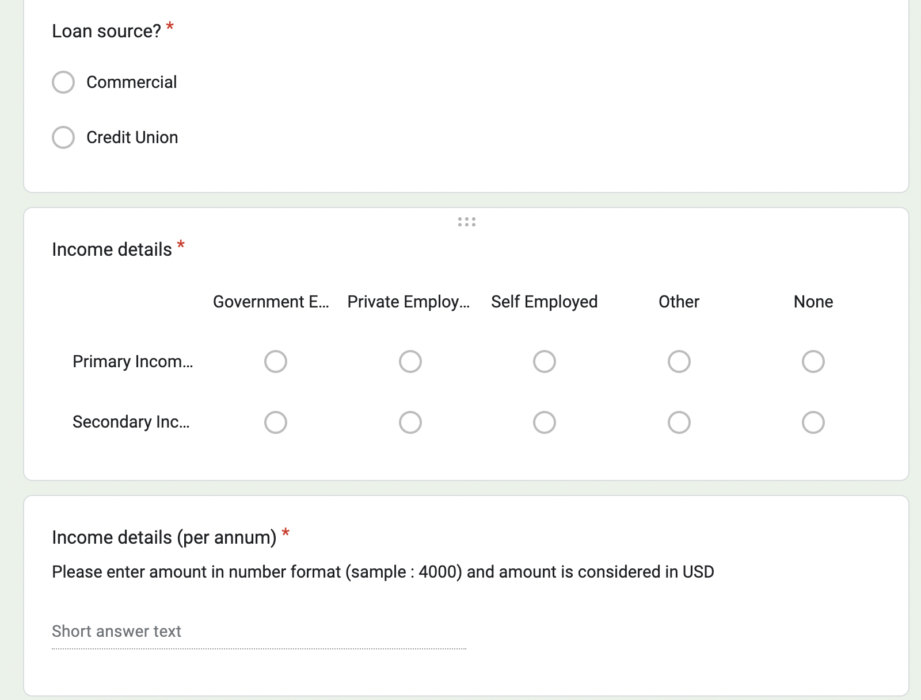
SNAPSHOTs OF GOOGLE SURVEY FORM

Slide 15
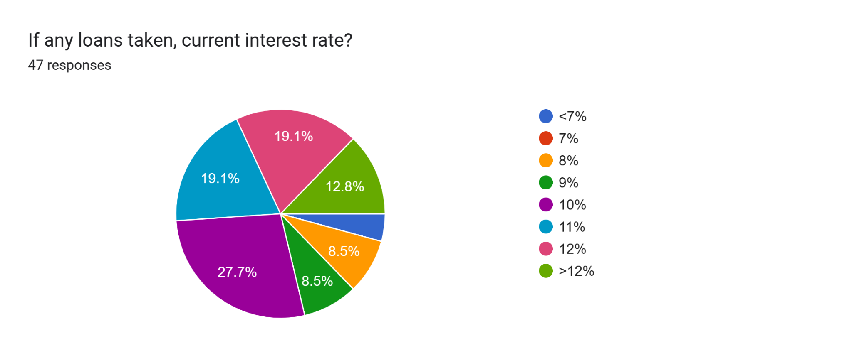
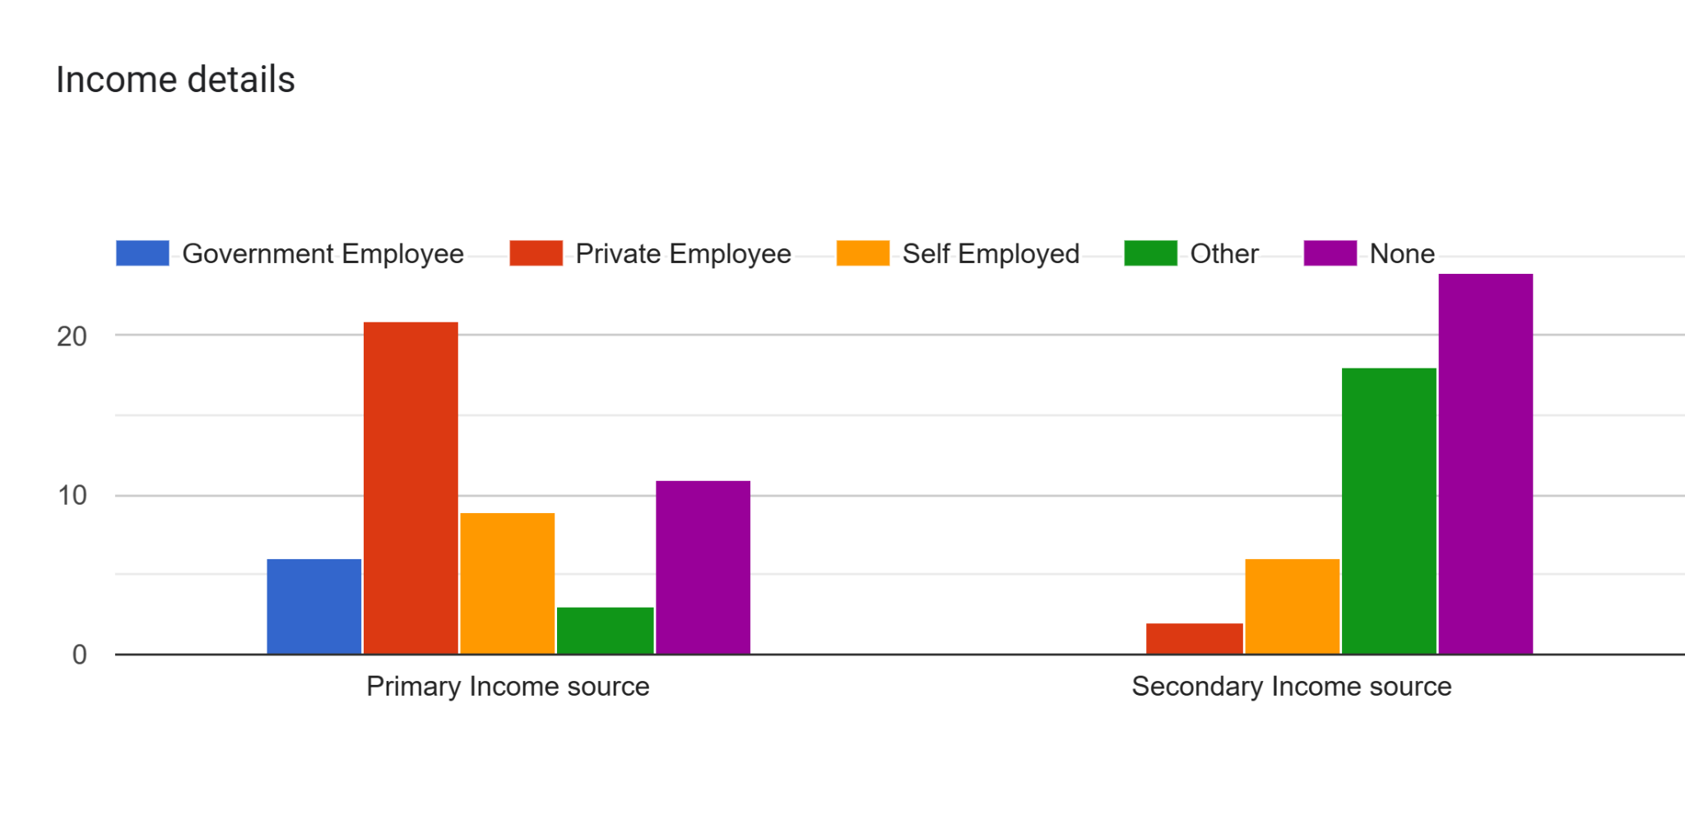
GOOGLE SURVEY ANALYSIS REPORT
The pie chart shows the different interest rates that the respondents are paying currently. From the chart, we can see that almost 28% of the respondents are paying 10% APR. Equal number of people are paying 11% APR and 12% APR with around 19% of respondents respectively. Only 4% of the respondents are paying less than 7% APR
Exploring the income of the respondents who have taken loans, we can see that the primary income source for majority of the respondents is by working at a private organization and majority of the respondents do not have any secondary source of income.

Slide 16
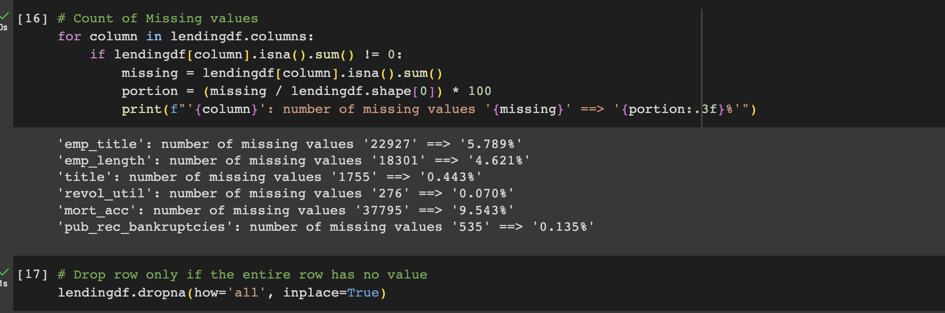
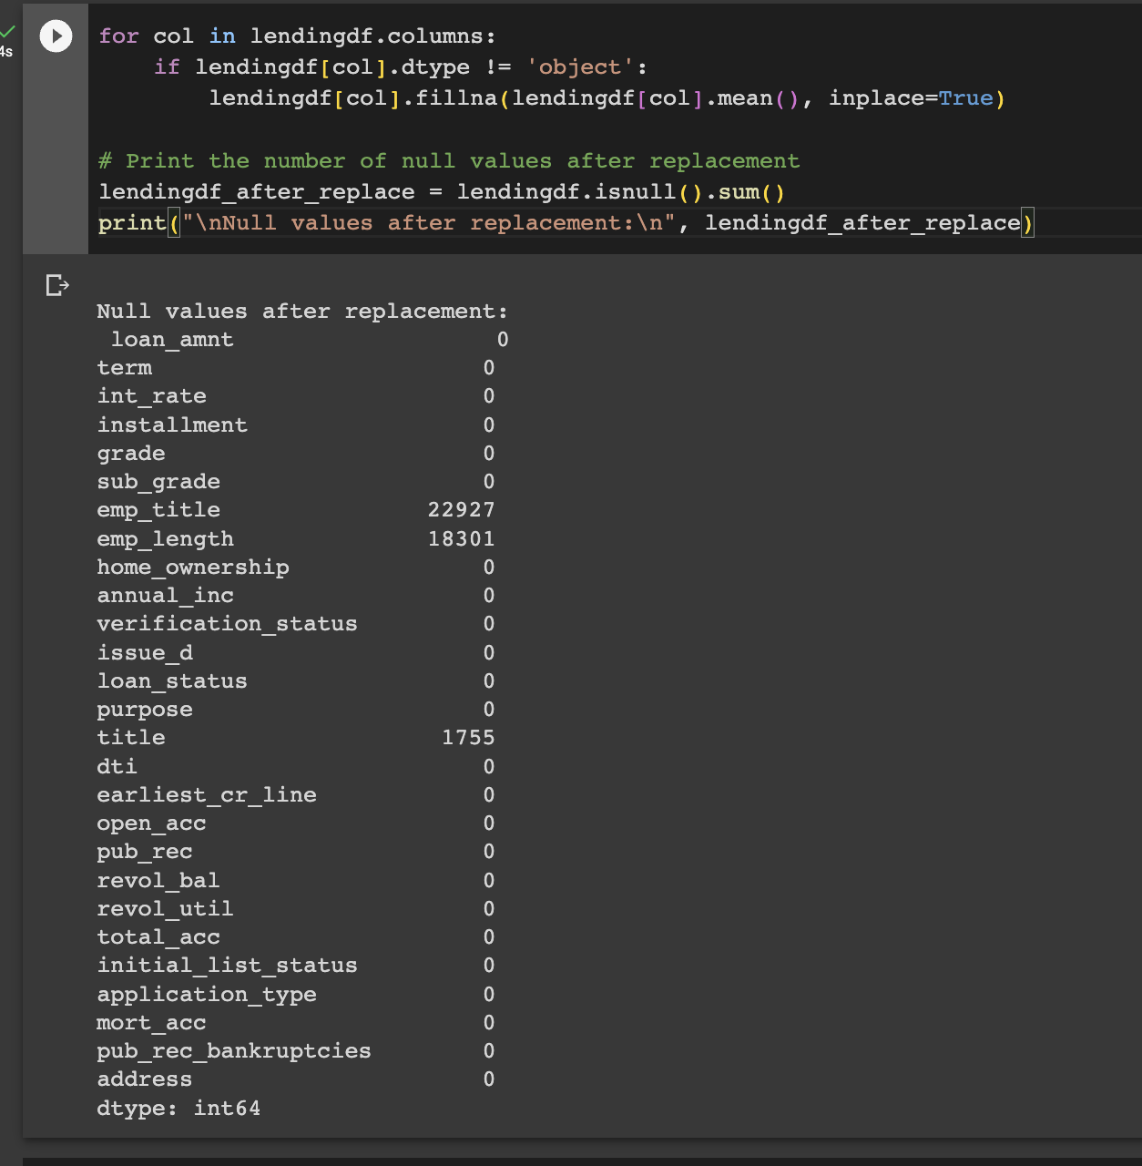
DATA PREPROCESSING : DATA CLEANING (LOAN DATASET)
This step involves checking the missing values or inconsistent values and removing them if the entire row is NULLs. It so, replace the null values in the numerical column with the average value of the entire column.

Slide 17
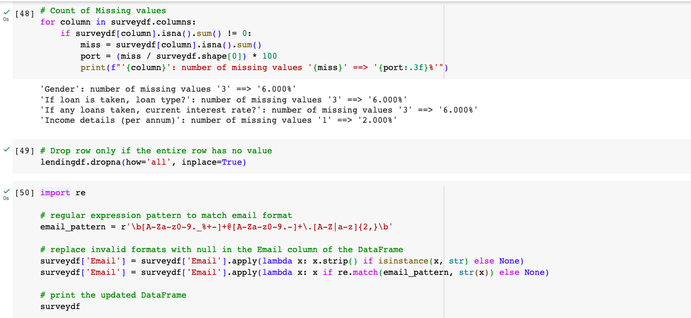
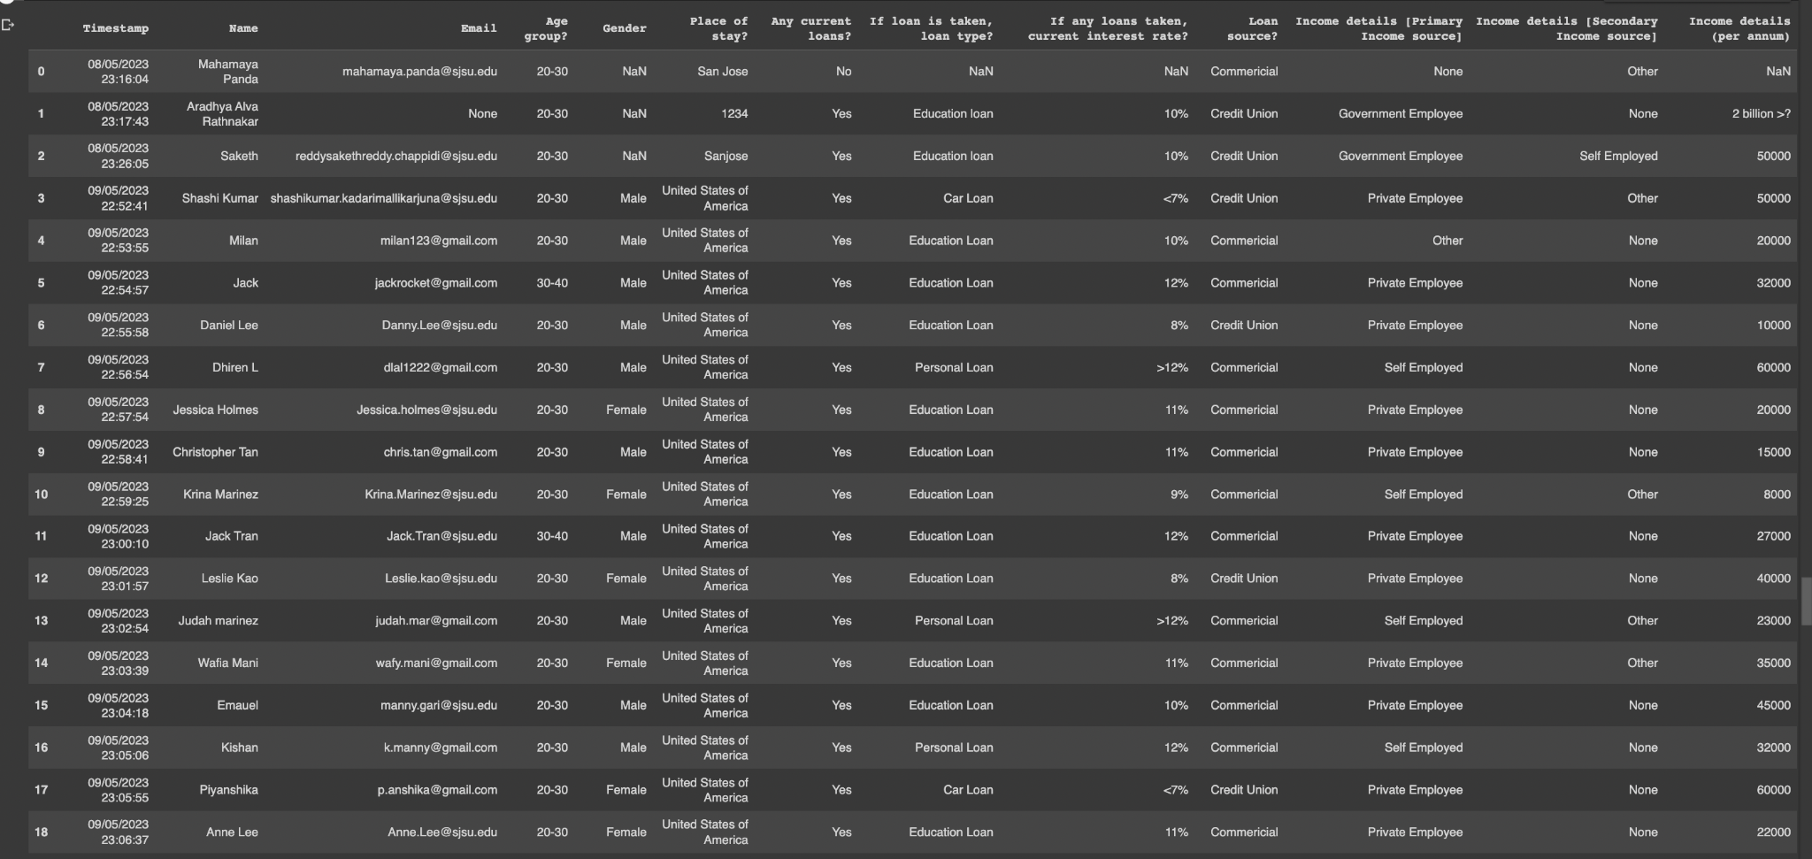
DATA PREPROCESSING : DATA CLEANING (SURVEY DATA)
This step involves the cleansing of survey data in terms of missing values and improper data. Data values that are null in all the columns have been dropped. The email format of email column data is been filtered down according to the right format and the improper data is being replaced with null values.

Slide 18
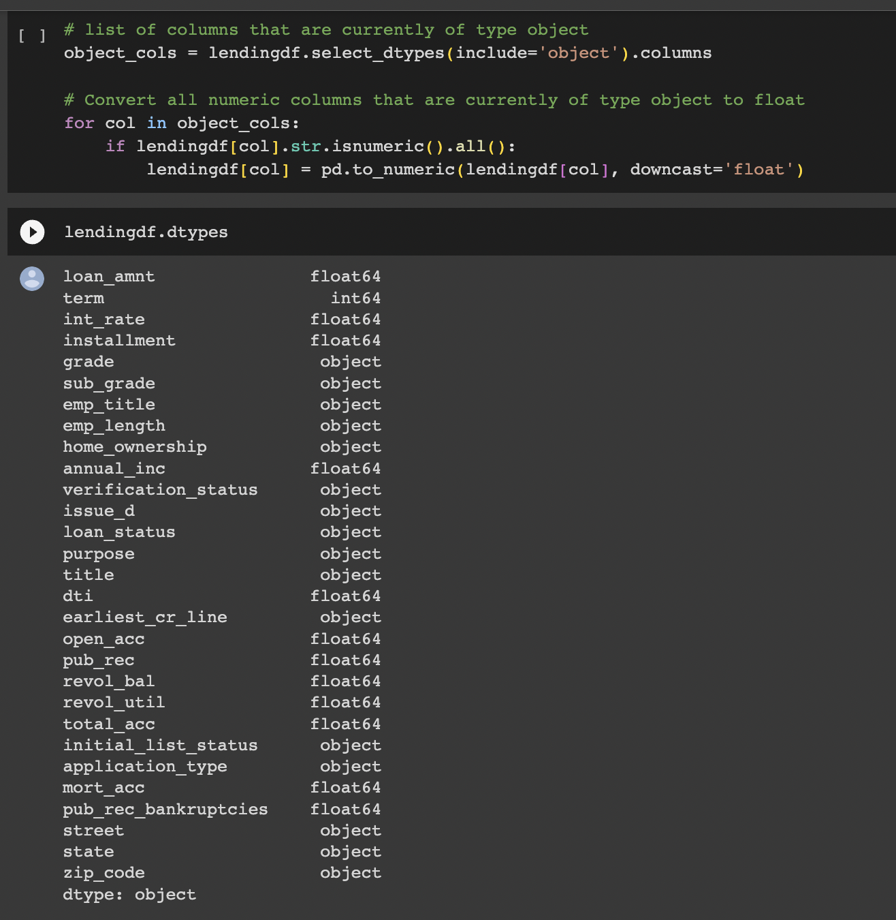
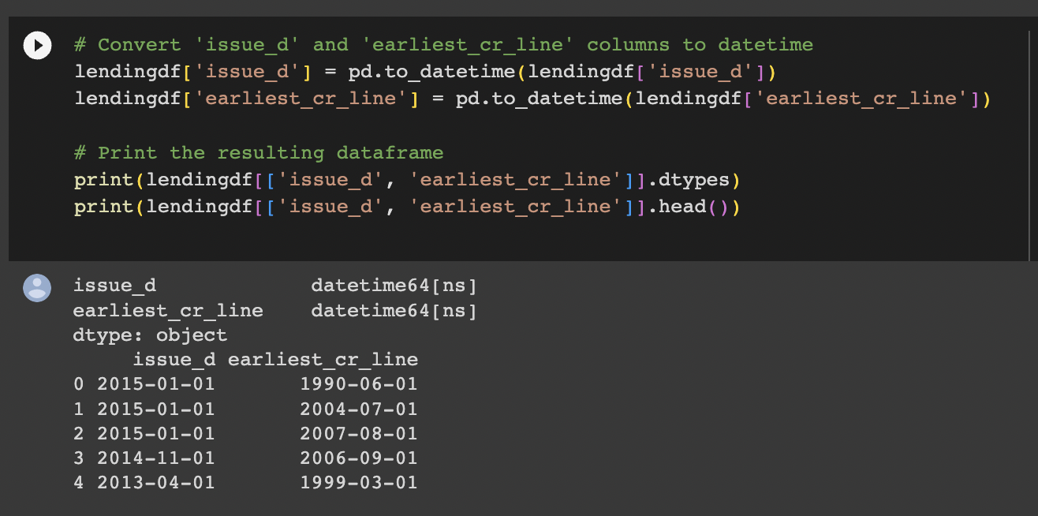
DATA PREPROCESSING : DATA TRANSFORMATION
This step involves the transformation of data that are of the type object to float if the values inside the columns are numerical but the inputs are in string format. This step also converts two columns to date-time format which makes the operations and analysis much easier and more efficient.

Slide 19
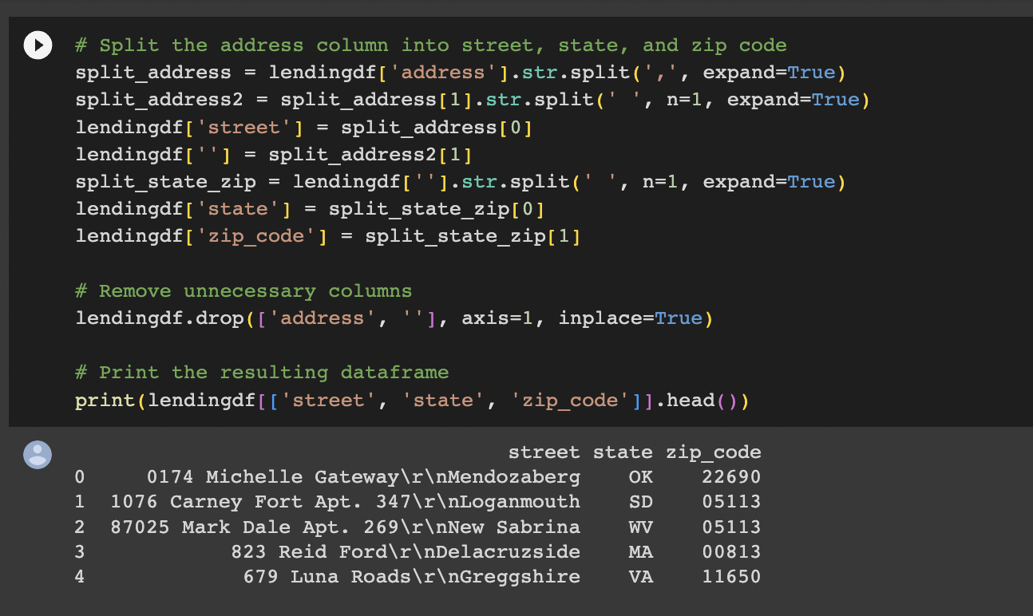
DATA PREPROCESSING : DATA REDUCTION
This step breaks the data into simpler proportions to enable easier processing and analysis of data. The term column is shortened down to a numerical value to make it easier for conditions and comparisons. The address column is broken down into simpler aspects such as street, state, and pin code to get a deeper and independent focus for analysis.

Slide 20
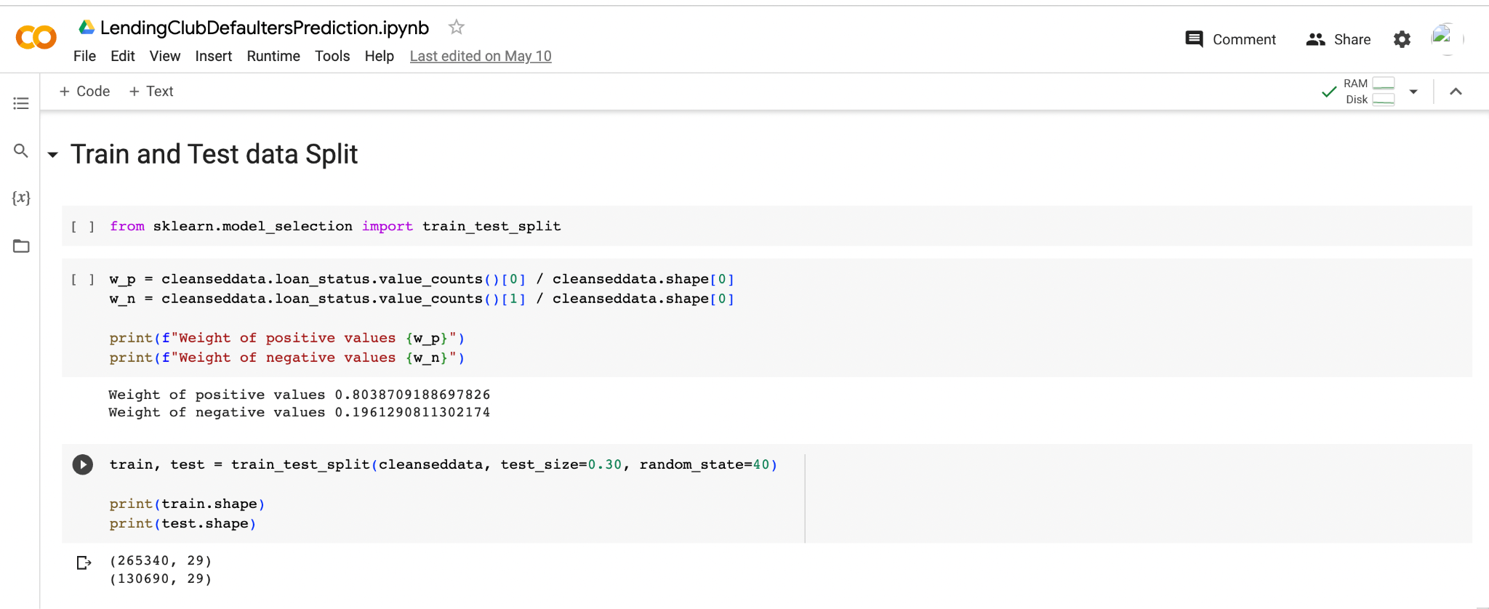
DATA MODELING
In the "Train and Test Data Split" step, we are dividing the dataset into two separate sets: a training set and a testing set. It is done to evaluate the performance of our predictive model on unseen data.
We randomly select a portion of the dataset to be used as the training set. The subset of data is used to train the machine learning model, allowing it to learn patterns and relationships between the input features and the target variable.
The remaining portion of the dataset is set aside as the testing set. This set is not used during the training phase but is used to evaluate the model's performance after training.
By splitting the data into these two sets, we can assess the model's accuracy, evaluate its performance metrics and make any necessary adjustments or improvements before deploying the model for real-world predictions.

Slide 21
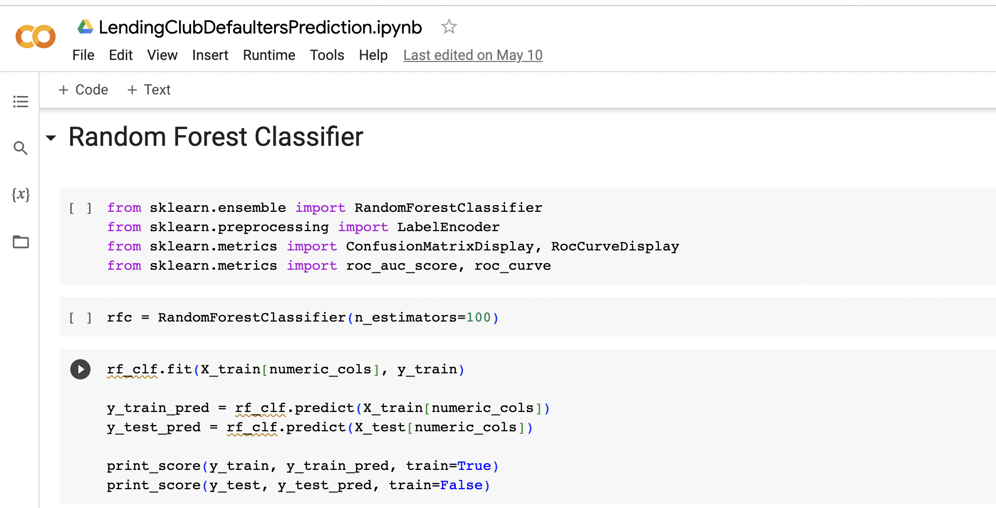
RANDOM FOREST CLASSIFIER
The code initializes and trains a Random Forest Classifier on the training data, followed by making predictions on both the training and test data.
The performance metrics, including accuracy, classification report, and confusion matrix, are then printed using the print_score() function.

Slide 22
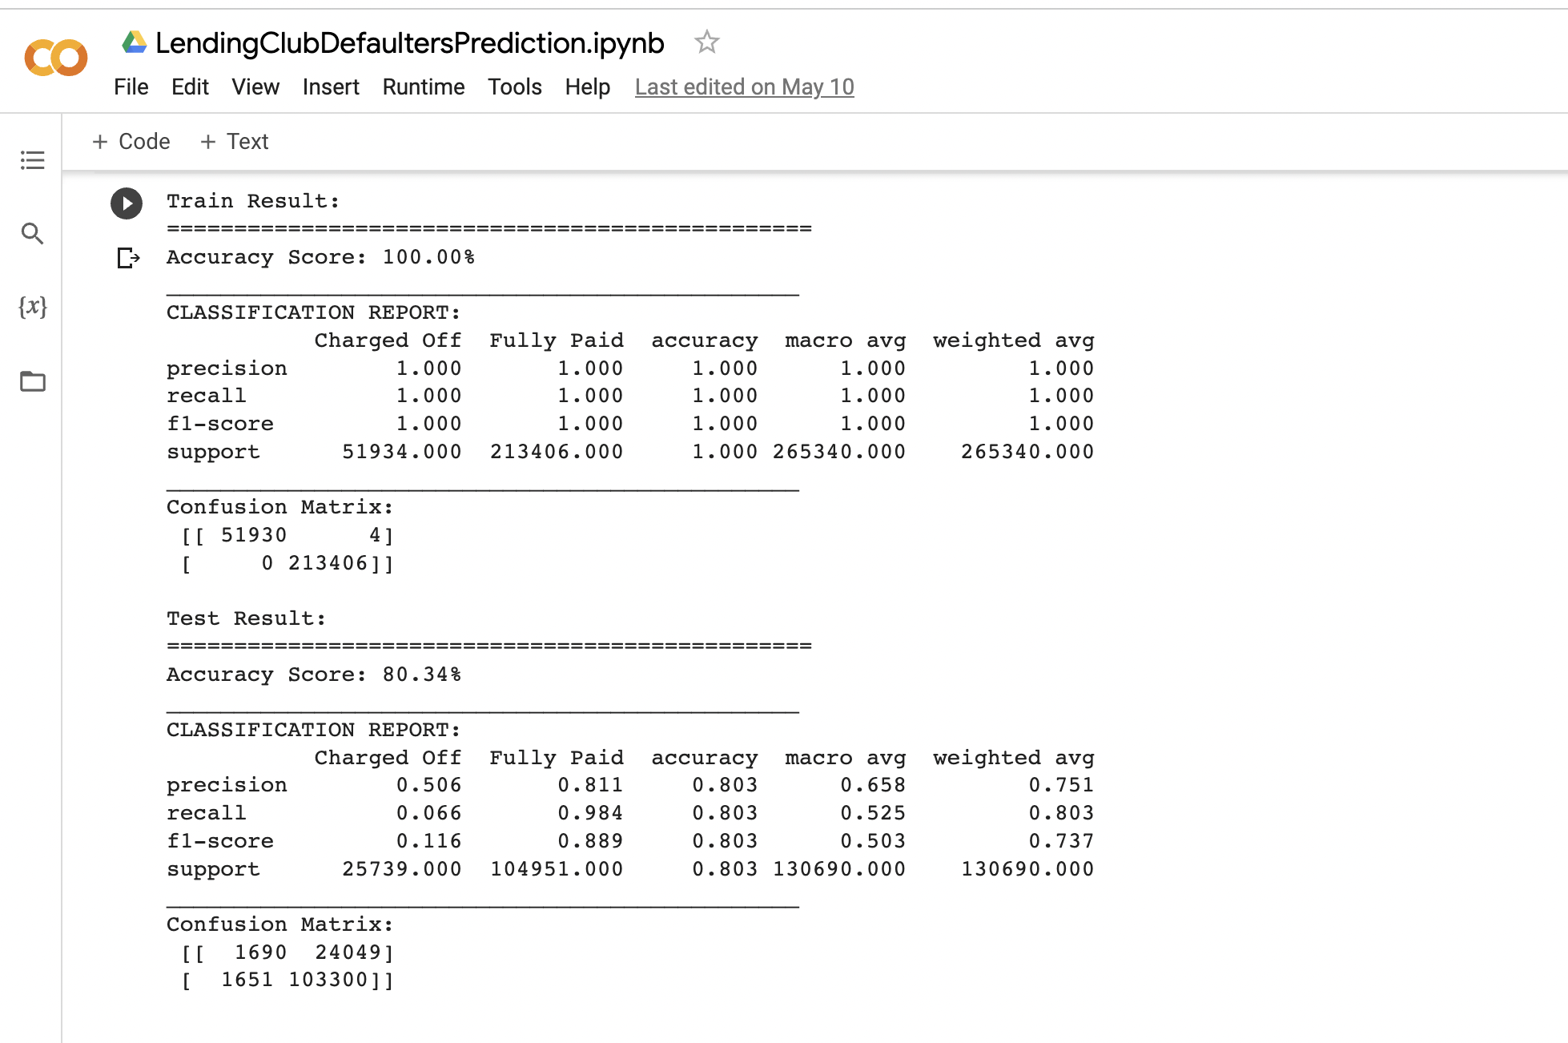
RANDOM FOREST CLASSIFIER (cont’d)
In the training set, the Random Forest Classifier achieved a perfect accuracy of 100% with only four misclassifications.
However, in the test set, the accuracy dropped to 80.34%, indicating some misclassifications.
The model performed better in predicting "Fully Paid" instances with high precision and recall but showed lower precision and recall for "Charged Off" instances, suggesting room for improvement.

Slide 23
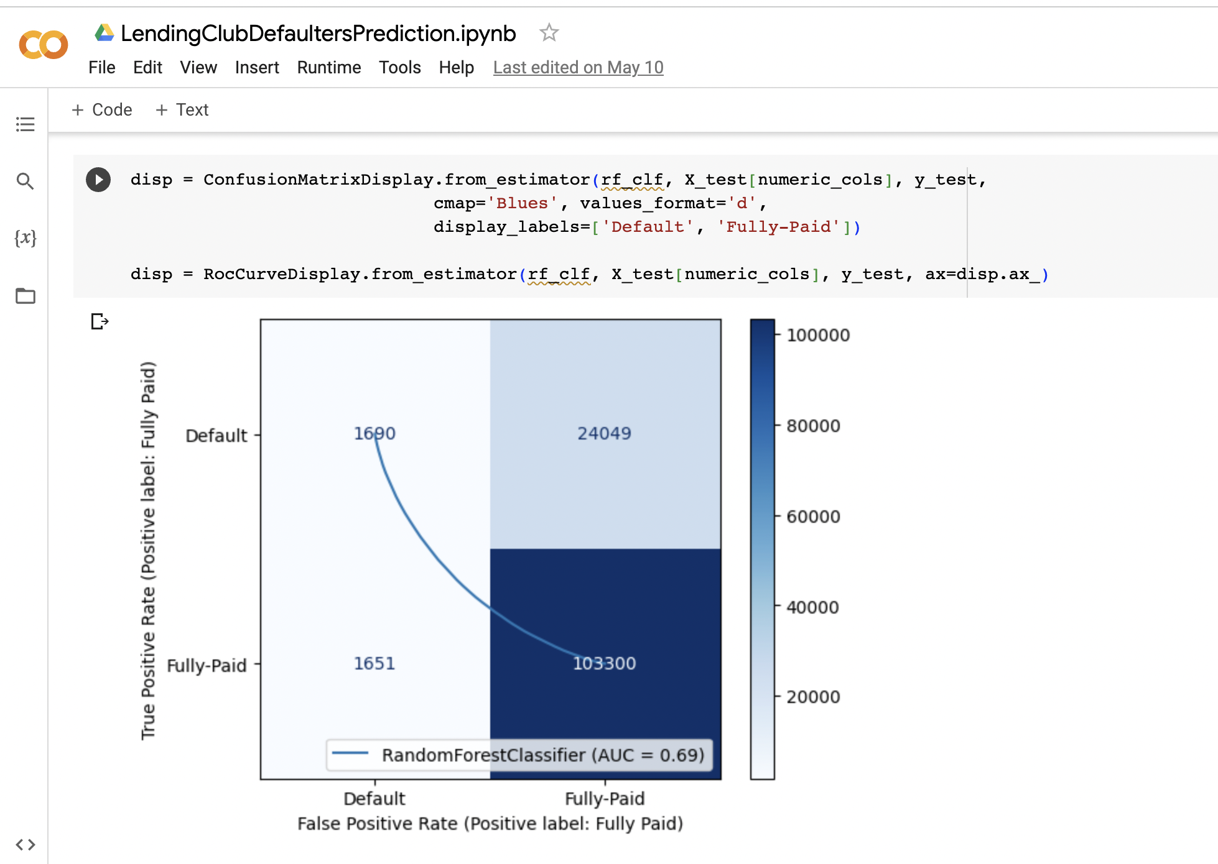
CONFUSION MATRIX
The code segment generates a ConfusionMatrixDisplay, showcasing the performance of the Random Forest Classifier on test data. The display presents true positive, false positive, true negative, and false negative counts, using a blue color map.
The RocCurveDisplay is then created, illustrating the ROC curve overlaid on the ConfusionMatrixDisplay, highlighting the relationship between the true positive rate and the false positive rate at various classification thresholds.

Slide 24
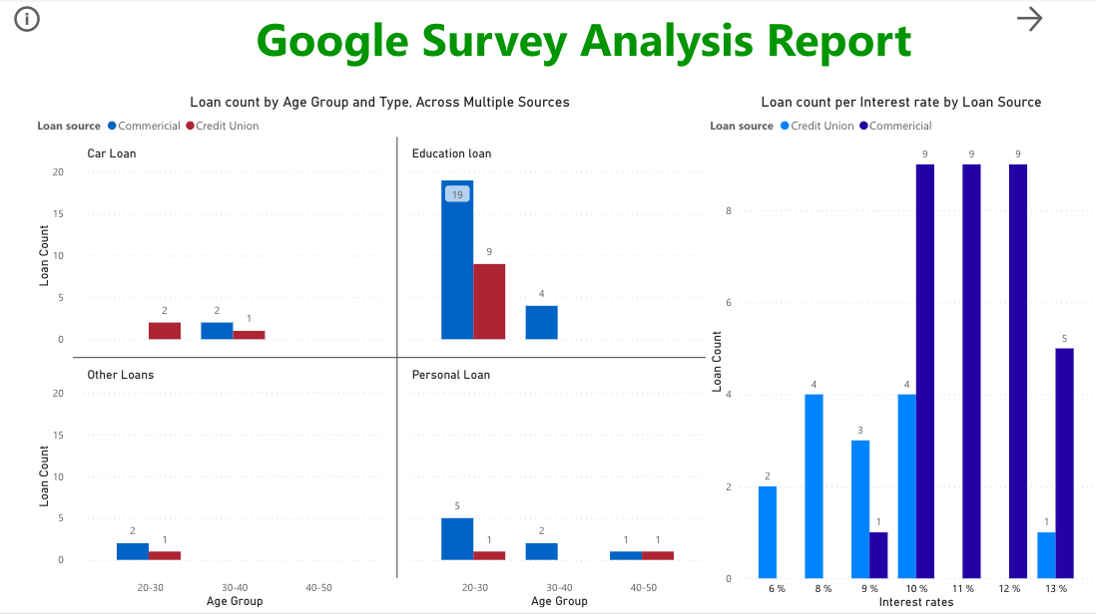
DATA VISUALIZATION
The report is created to analyze and visualize SJSU live survey data. From the data, we focus on the analysis of different types of loans that the respondents have taken and the current interest rates they are paying, in general, to compare it with the Lending Club company to compare the competition. Clustered bar charts were used for comparison between the different loan sources. On the left side, we have the analysis of the number of loans taken by each age group from different types of banks.
From our survey data, we can see that it is a common trend to take loans from a commercial bank. We further analyzed the interest rates that the people are paying currently for the loans they have taken.

Slide 25
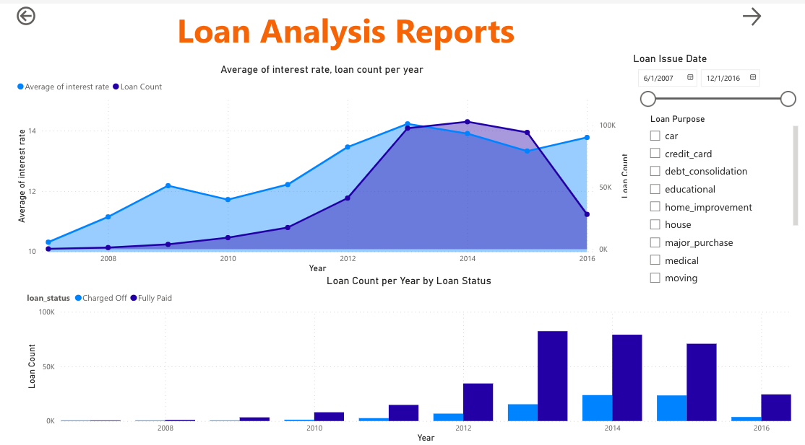
DATA VISUALIZATION
The report provides insights into changing average interest rates and loan issuance trends over time, allowing users to identify patterns and areas for improvement.
By filtering data based on issue dates and purposes, users can analyze the impact of verification status on interest rates and loan volume.
The side-by-side bar chart, filtered for issue dates after June 1, 2007, helps identify loan issuance trends and potential seasonal patterns in lending activity.
Hence, the report offers valuable information for understanding loan dynamics and optimizing lending practices.

Slide 26
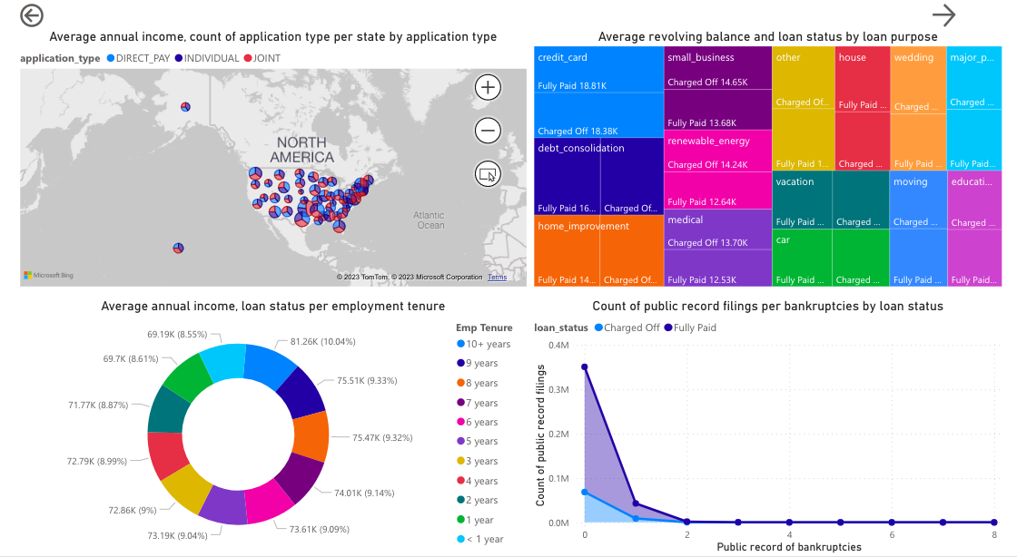
DATA VISUALIZATION
The report provides valuable insights through various visualizations.
The maps show average annual income and application types by state, while the tree map displays the average revolving balance by loan status and purpose.
The donut chart depicts loan status based on annual income and tenure, with a hover feature showing detailed information.
The line graph compares public filings and bankruptcies, indicating that many applicants fully paid their loans before bankruptcy, but a significant number faced bankruptcy before repayment completion.

Slide 27
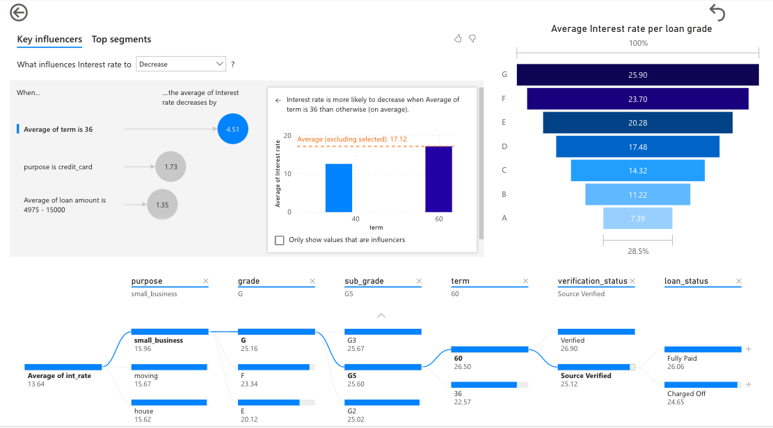
DATA VISUALIZATION
The report focuses on identifying factors that influence interest rate fluctuations.
The analysis reveals that interest rates tend to decrease with an average loan term of 36 months, loans for credit cards, and loan amounts ranging from $4975 to $15000.
These influential factors are visually represented in the top left plot and further explored in the network plot, which illustrates the relationships among various attributes.
For instance, when the average interest rate is 13.64 and specific criteria are met regarding purpose, loan grade, subgrade, term, and verification status, the statistics show a higher percentage of fully paid loans compared to charged-off loans.

Slide 28

The Power BI report is deployed from a local environment to Power BI Online. It enables increased user collaboration and accessibility.
As a result, publishing the Power BI report to Power BI Online increases accessibility, encourages collaboration, makes it possible to update data, makes sharing and distribution easier, and ensures security and governance. It enables users to fully utilize the report's potential and make data-driven decisions in a secure and collaborative setting.

Slide 29
IMPACT
The analysis of the "LendingClub" dataset has had a significant impact on the domain of credit risk assessment and loan investments.
Better Risk Assessment: The lending sector has been significantly impacted by the development and enhancement of a prediction model for identifying potential loan defaulters using the dataset.
Improved Decision-Making: The dataset has offered insightful information about the elements that affect loan default.
Industry Impact: The dataset analysis revealed information that had an impact on the lending sector as a whole. The findings can be used by lending platforms and financial institutions to improve their loan approval workflows, risk management procedures, and portfolio management.
Risk reduction: Using the Random Forest Classifier and the analysis, lenders may identify high-risk loan applicants and put the right risk reduction measures in place. It can entail changing interest rates, tightening eligibility requirements, or offering more assistance to debtors who are thought to be at risk of default.

Slide 30

CONCLUSION
This analysis utilizes the Random Forest Classifier to minimize loan investment risks by analyzing the Lending Club loan defaulters dataset.
The study develops a predictive model that identifies potential defaulters and improves decision-making accuracy.
Hence, it emphasizes the need for the model to be used as a supportive tool and calls for further research and refinement for real-world lending scenarios.

Slide 31

FUTURE SCOPE
Model Optimization: Investigating various techniques to optimize the Random Forest Classifier model specifically for loan default prediction.
Feature Engineering: Exploring additional feature engineering techniques to enhance the predictive power of the model.
Ensemble Methods: Exploring the combination of Random Forest Classifier with other machine learning algorithms or ensemble methods to create hybrid models.
Imbalanced Data Handling: Addressing the issue of imbalanced data, where the number of non-defaulting loans significantly outweighs the number of defaulting loans.
Interpretability and Explainability: Investigating methods to enhance the interpretability and explainability of the Random Forest Classifier model.
Real-time Prediction and Monitoring: Extending the model to enable real-time loan default predictions, monitoring, and setting up automated monitoring systems to identify and flag potential default risks in real-time.
Integration with Portfolio Management Systems: Integrating the loan default prediction model with portfolio management systems used by lenders and investors.

Slide 32
REFERENCES
[1] “Credit risk assessment: a challenge for financial institutions" by Evangelos Kalapodas; Mary E. Thomsom : https://ieeexplore.ieee.org/document/8132501/authors#authors
[2] "Data Visualization and its Key Fundamentals: A Comprehensive Survey" by Muscan, Gurpreet Singh, Jaspreet Singh, and Chander Prabha :
https://ieeexplore.ieee.org/document/9835803
[3] “The Application Study of Credit Risk Model In Financial Institution via Machine-learning Algorithms" by Yuanzhang Wang; Jiongcheng Lu; Jiehan Qin; Chenyi Zhang; Yiyang Chen :
https://ieeexplore.ieee.org/document/9532215
[4] “Comparative Breast Cancer Detection with Artificial Neural Networks and Machine Learning Methods” by Muhammed Coşkun Irmak; Mehmet Bilge Han Taş; Sedat Turan; Abdulsamet Haşiloğlu :
https://ieeexplore.ieee.org/document/9477991
[5] SAYAH, F. (2023, February). Lending Club Dataset, Version 1. Retrieved March 20, 2023 from https://www.kaggle.com/code/faressayah/lending-club-loan-defaulters-prediction/input.

Slide 33



